Slide 1
Primary v Secondary Sources

Slide 2
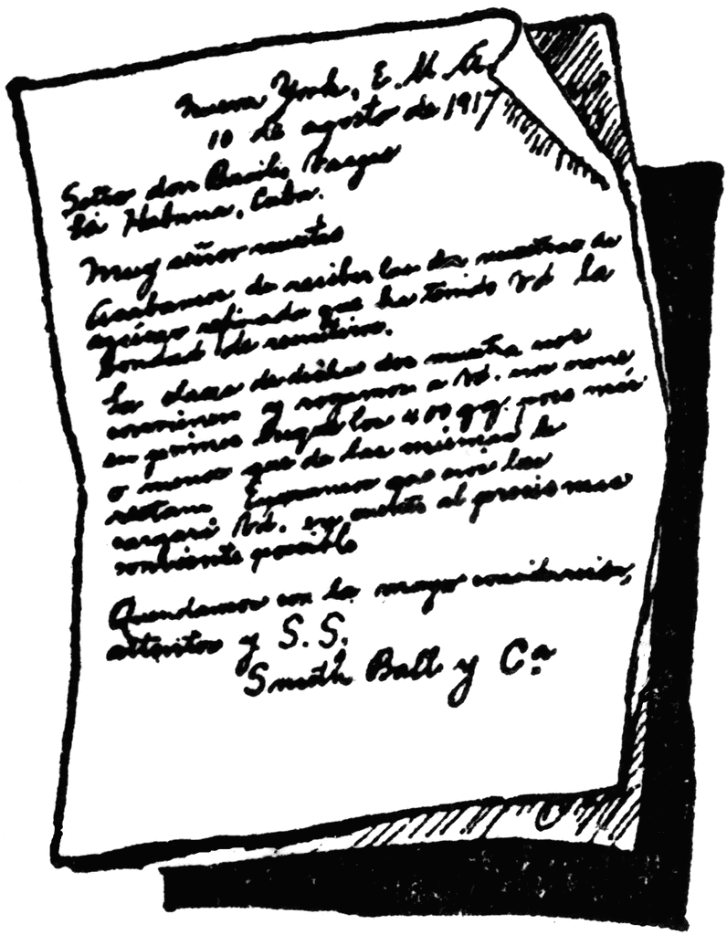
Primary Sources
Primary sources are original records, created by someone who participated or witness something firsthand.
Primary sources can give you a wide variety of opinions or views on a specific event or topic.
Examples: oral histories, photographs, clothing, weapons, letters, legal agreements, sound recordings, etc.
(“Teaching Primary and Secondary Sources”, 2011.)

Slide 3
Why are Primary Sources hard to understand?
When looking at a hand written document- Grammar and handwriting can make using primary sources difficult to read and or understand
Depending on what you are researching, primary sources could be in a different language.
You could very easily find two or three documents that all give a different explain or reason of a particular event.
Why?

Slide 4
Secondary Sources
Secondary sources are documents of some kind that are about an event, person, or issue, that was created by someone who did not witness something first hand.
People who write secondary sources often consult and read primary sources to gather information
Examples: Textbooks, biographies, summaries
(“Teaching Primary and Secondary Sources”, 2011.)

Slide 5
References
Teaching Primary and Secondary Sources. (2011, January 1). Retrieved November 1, 2014, from http://www.georgewbushlibrary.smu.edu/ en/Teachers/Classroom-Resources/Primary-Sources-Toolkit.aspx

